Slide 1

Natural Language Processing
Yue Zhang
Westlake University

Slide 2
Chapter 11
Transition-based Methods for Structured Prediction

Slide 3
Contents
11.1 Transition-based Structured Prediction
11.1.1 Greedy Local Modelling
11.1.2 Structured Modelling
11.2 Transition-based Constituent Parsing
11.2.1 Shift-reduce Constituent Parsing
11.2.2 Feature Templates
11.3 Shift-reduce Dependency Parsing
11.3.1 Arc-standard Dependency Parsing
11.3.2 Arc-eager Projective Parsing
11.3.3 The Swap Action and Non-projective Trees
11.4 Joint Models
11.4.1 Joint POS-tagging and Dependency Parsing
11.4.2 Joint Word Segmentation, POS-tagging and Dependency Parsing

Slide 4
Contents
11.1 Transition-based Structured Prediction
11.1.1 Greedy Local Modelling
11.1.2 Structured Modelling
11.2 Transition-based Constituent Parsing
11.2.1 Shift-reduce Constituent Parsing
11.2.2 Feature Templates
11.3 Shift-reduce Dependency Parsing
11.3.1 Arc-standard Dependency Parsing
11.3.2 Arc-eager Projective Parsing
11.3.3 The Swap Action and Non-projective Trees
11.4 Joint Models
11.4.1 Joint POS-tagging and Dependency Parsing
11.4.2 Joint Word Segmentation, POS-tagging and Dependency Parsing

Slide 5
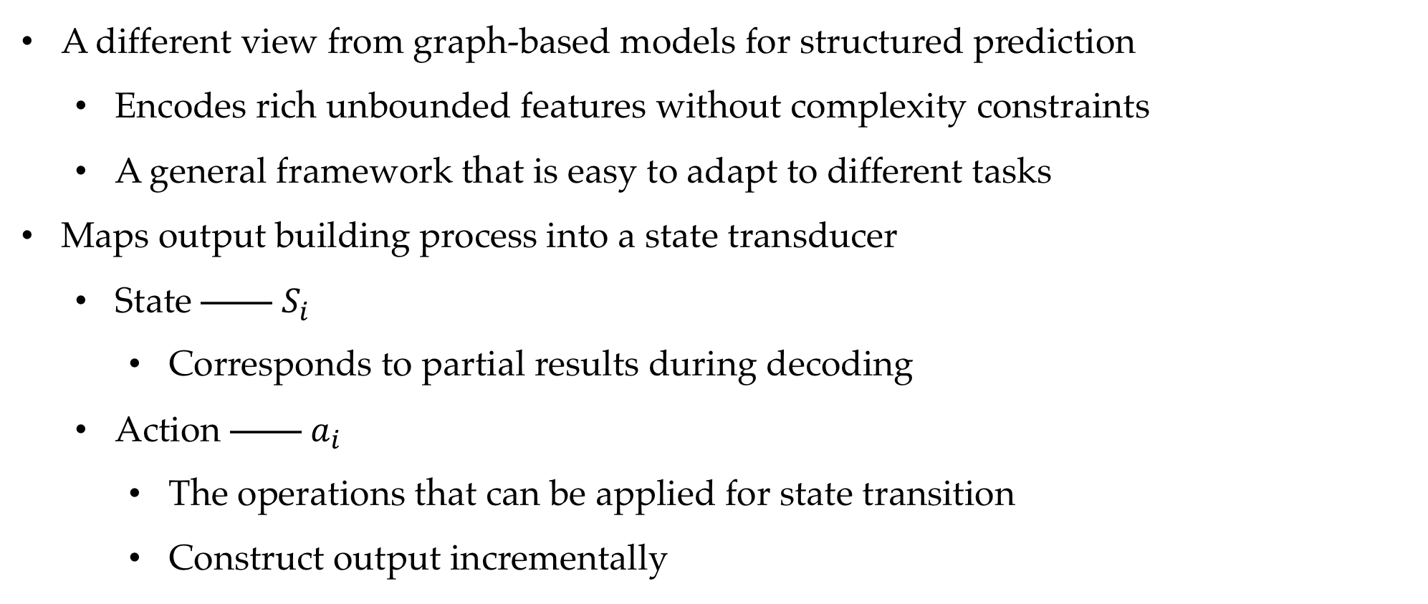
A Transition System
A different view from graph-based models for structured prediction
Encodes rich unbounded features without complexity constraints
A general framework that is easy to adapt to different tasks
Maps output building process into a state transducer
State —— $S_{i}$
Corresponds to partial results during decoding
Action —— $a_{i}$
The operations that can be applied for state transition
Construct output incrementally

Slide 6
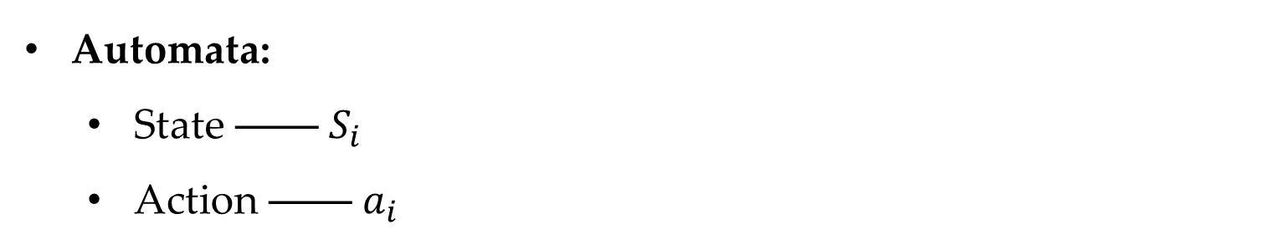
A Transition System
Automata:
State —— $S_{i}$
Action —— $a_{i}$
start

Slide 7
A Transition System
Automata:
State —— $S_{i}$
Action —— $a_{i}$
a₀
start
S₁

Slide 8
A Transition System
Automata:
State —— $S_{i}$
Action —— $a_{i}$
a₀
a₁
start
S₁
…

Slide 9
A Transition System
Automata:
State —— $S_{i}$
Action —— $a_{i}$
a₀
a₁
a_{i-1}
start
S₁
S_{i}
…

Slide 10
A Transition System
Automata:
State —— $S_{i}$
Action —— $a_{i}$
a₀
a₁
a_{i-1}
a_{i}
start
S₁
S_{i}
…
…

Slide 11
A Transition System
Automata:
State —— $S_{i}$
Action —— $a_{i}$
a₀
a₁
a_{i-1}
a_{i}
a_{n-1}
start
S₁
S_{i}
S_{n}
…
…

Slide 12
A Transition System
Automata:
State —— $S_{i}$
Action —— $a_{i}$
a₀
a₁
a_{i-1}
a_{i}
a_{n-1}
a_{n}
start
S₁
S_{i}
S_{n}
end
…
…

Slide 13
Transition-based structured prediction
Transition-based structured prediction is a state transition process.
Automata:
State
Start state —— an empty structure
End state —— the output structure
Intermediate state —— partially constructed structures
Transition actions
Incremental steps that build output structures, change one state to another

Slide 14
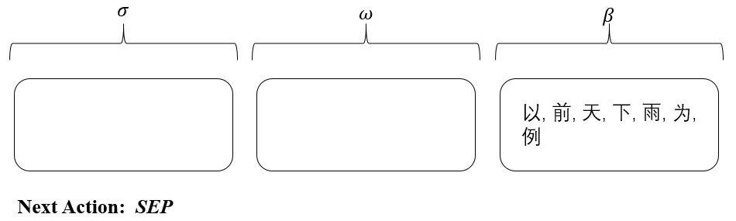
Example (Word Segmentation)
Input："以(take) 前(before) 天(day) 下(fall) 雨(rain) 为(be) 例(example)"
$σ$: partial output $w$: current partial word $β$: list of next incoming characters

Slide 15
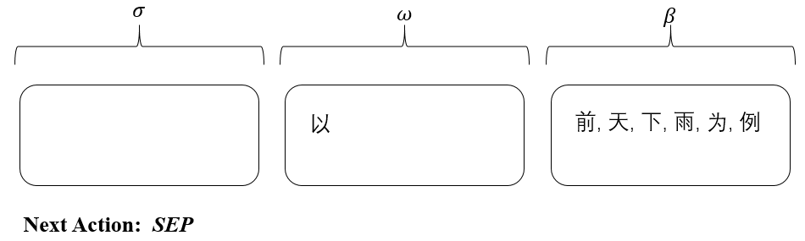
Example (Word Segmentation)
Input："以(take) 前(before) 天(day) 下(fall) 雨(rain) 为(be) 例(example)"
$σ$: partial output $w$: current partial word $β$: list of next incoming characters

Slide 16

Example (Word Segmentation)
Input："以(take) 前(before) 天(day) 下(fall) 雨(rain) 为(be) 例(example)"
$σ$: partial output $w$: current partial word $β$: list of next incoming characters

Slide 17
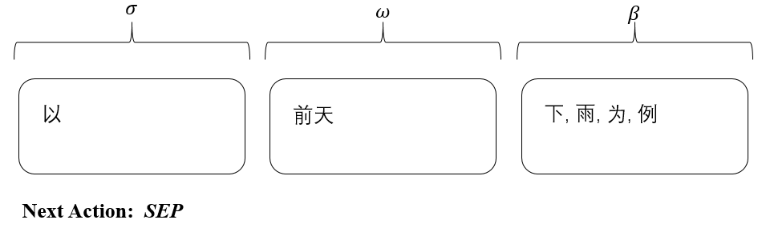
Example (Word Segmentation)
Input："以(take) 前(before) 天(day) 下(fall) 雨(rain) 为(be) 例(example)"
$σ$: partial output $w$: current partial word $β$: list of next incoming characters

Slide 18
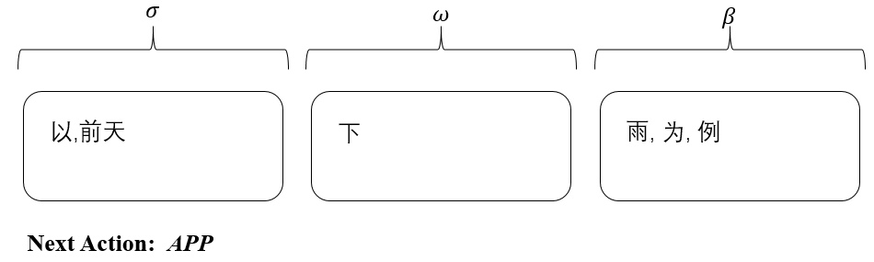
Example (Word Segmentation)
Input："以(take) 前(before) 天(day) 下(fall) 雨(rain) 为(be) 例(example)"
$σ$: partial output $w$: current partial word $β$: list of next incoming characters

Slide 19
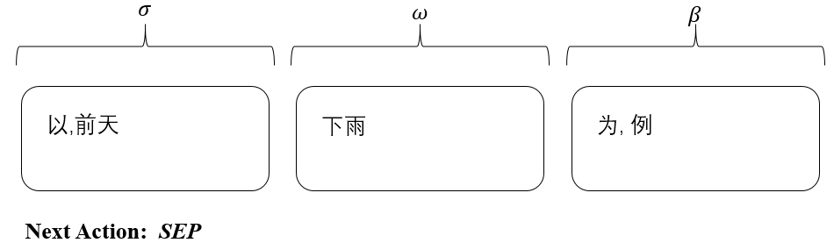
Example (Word Segmentation)
Input："以(take) 前(before) 天(day) 下(fall) 雨(rain) 为(be) 例(example)"
$σ$: partial output $w$: current partial word $β$: list of next incoming characters

Slide 20
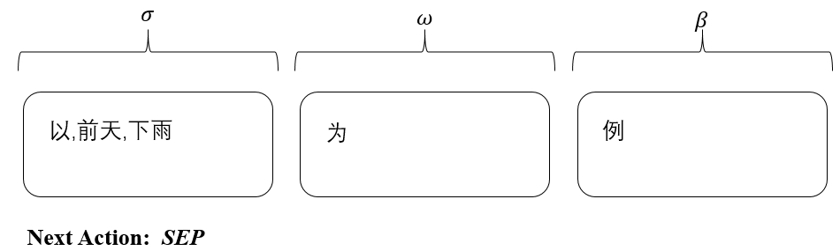
Example (Word Segmentation)
Input："以(take) 前(before) 天(day) 下(fall) 雨(rain) 为(be) 例(example)"
$σ$: partial output $w$: current partial word $β$: list of next incoming characters

Slide 21
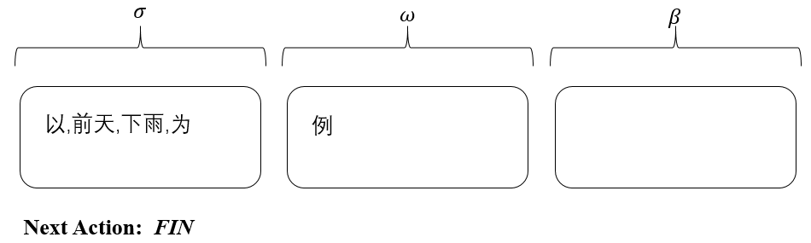
Example (Word Segmentation)
Input："以(take) 前(before) 天(day) 下(fall) 雨(rain) 为(be) 例(example)"
$σ$: partial output $w$: current partial word $β$: list of next incoming characters

Slide 22
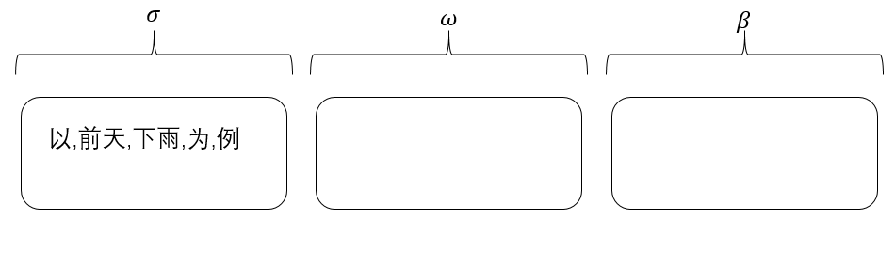
Example (Word Segmentation)
Input："以(take) 前(before) 天(day) 下(fall) 雨(rain) 为(be) 例(example)"
$σ$: partial output $w$: current partial word $β$: list of next incoming characters

Slide 23
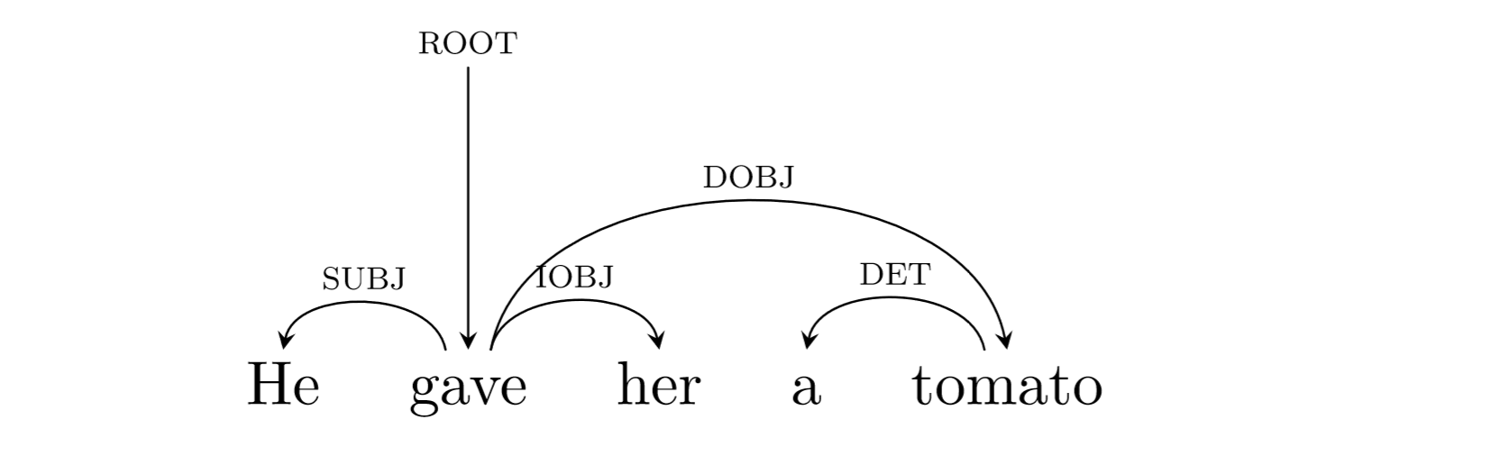
Example (Dependency Parsing)

Slide 24
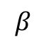
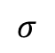
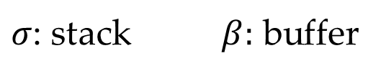
Example (Dependency Parsing)
$$σ$$
$$β$$
He does it here
$σ$: stack $β:$ buffer

Slide 25
Example (Dependency Parsing)
NEXT ACTION: $Shift$
$$σ$$
$$β$$
He does it here
$σ$: stack $β:$ buffer

Slide 26
Example (Dependency Parsing)
NEXT ACTION: $Left−Arc$
$$σ$$
$$β$$
He
does it here
$σ$: stack $β:$ buffer

Slide 27
Example (Dependency Parsing)
NEXT ACTION: $Shift$
$$σ$$
$$β$$
does it here
He
$σ$: stack $β:$ buffer

Slide 28
Example (Dependency Parsing)
NEXT ACTION: $Right−Arc$
$$σ$$
$$β$$
does
it here
He
$σ$: stack $β:$ buffer

Slide 29
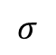
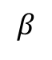
Example (Dependency Parsing)
NEXT ACTION: $Reduce$
$$σ$$
$$β$$
does it
here
He
$σ$: stack $β:$ buffer

Slide 30
Example (Dependency Parsing)
NEXT ACTION: $Right−Arc$
$$σ$$
$$β$$
does
here
He it
$σ$: stack $β:$ buffer

Slide 31
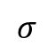
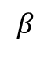
Example (Dependency Parsing)
NEXT ACTION: $Reduce$
$$σ$$
$$β$$
does here
He it
$σ$: stack $β:$ buffer

Slide 32
Example (Dependency Parsing)
NEXT ACTION: $Finish$
$$σ$$
$$β$$
does
He it here
$σ$: stack $β:$ buffer

Slide 33
Contents
11.1 Transition-based Structured Prediction
11.1.1 Greedy Local Modelling
11.1.2 Structured Modelling
11.2 Transition-based Constituent Parsing
11.2.1 Shift-reduce Constituent Parsing
11.2.2 Feature Templates
11.3 Shift-reduce Dependency Parsing
11.3.1 Arc-standard Dependency Parsing
11.3.2 Arc-eager Projective Parsing
11.3.3 The Swap Action and Non-projective Trees
11.4 Joint Models
11.4.1 Joint POS-tagging and Dependency Parsing
11.4.2 Joint Word Segmentation, POS-tagging and Dependency Parsing

Slide 34
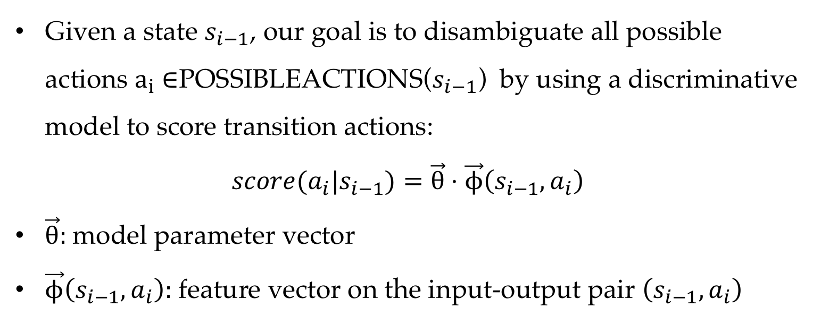
Transition-based Modeling
Given a state $s_{i−1}$, our goal is to disambiguate all possible actions $a_{i}$ ∈POSSIBLEACTIONS($s_{i−1}$) by using a discriminative model to score transition actions:
$$score(a_{i}|s_{i−1})=\vec{θ}⋅\vec{ϕ}\left(s_{i−1},a_{i}\right)$$
$\vec{θ}:$model parameter vector
$\vec{ϕ}\left(s_{i−1},a_{i}\right):$ feature vector on the input-output pair $\left(s_{i−1},a_{i}\right)$

Slide 35
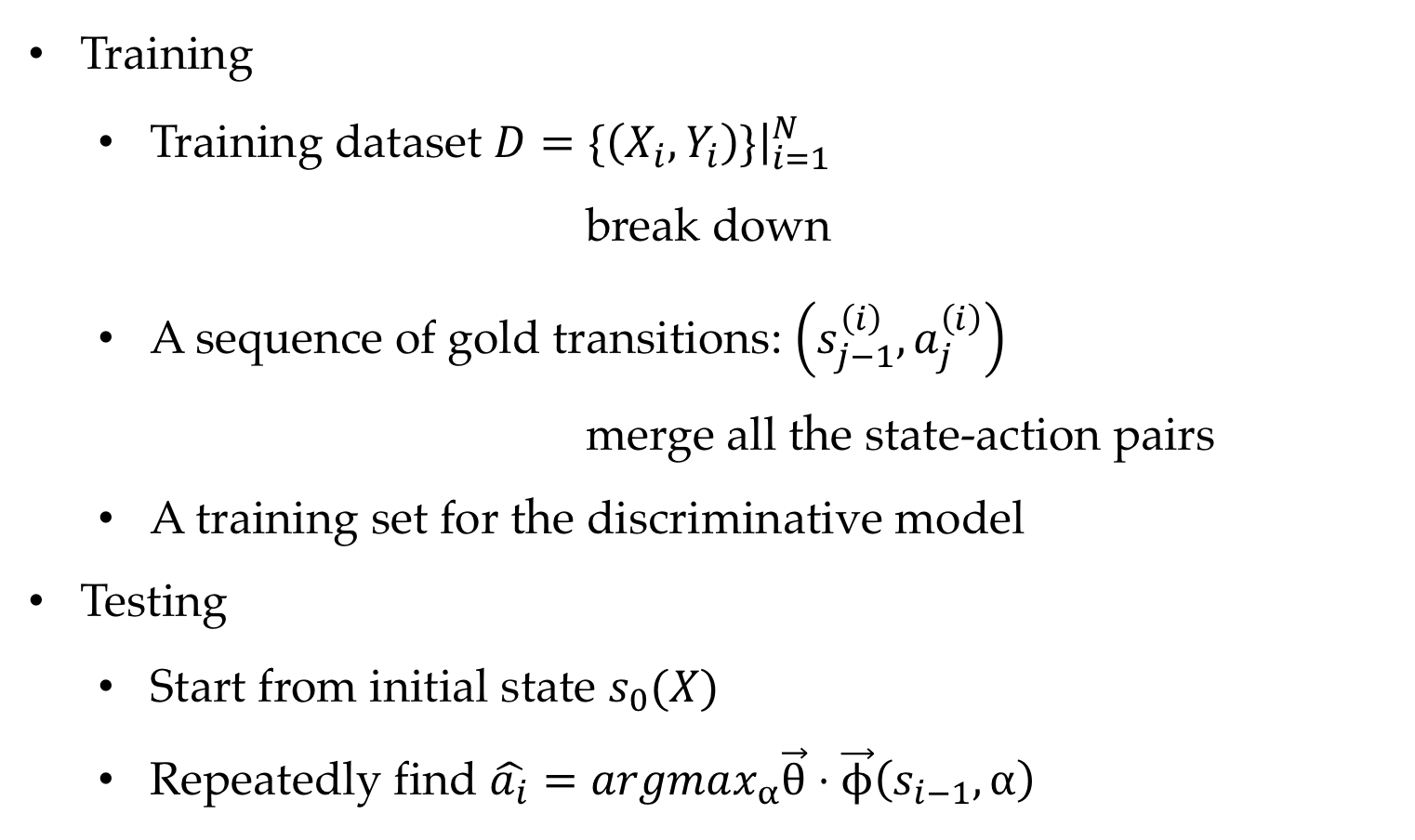
Greedy Local Method
Training
Training dataset $D=\{\left(X_{i},Y_{i}\right)\}{\left.​\right|}_{i=1}^{N}$
break down
A sequence of gold transitions: $\left(s_{j−1}^{\left(i\right)},a_{j}^{\left(i\right)}\right)$
merge all the state-action pairs
A training set for the discriminative model
Testing
Start from initial state $s_{0}(X)$
Repeatedly find $\hat{a_{i}}=argmax_{α}\vec{θ}⋅\vec{ϕ}\left(s_{i−1},α\right)$

Slide 36
Greedy Local Method
NEXT ACTION: $Shift$
$$σ$$
$$β$$
He does it here
$σ$: stack $β:$ buffer

Slide 37
Greedy Local Method
NEXT ACTION: $Left−Arc$
$$σ$$
$$β$$
He
does it here
$σ$: stack $β:$ buffer

Slide 38
Greedy Local Method
NEXT ACTION: $Shift$
$$σ$$
$$β$$
does it here
He
$σ$: stack $β:$ buffer

Slide 39
Greedy Local Method
NEXT ACTION: $Right−Arc$
$$σ$$
$$β$$
does
it here
He
$σ$: stack $β:$ buffer

Slide 40
Greedy Local Method
NEXT ACTION: $Reduce$
$$σ$$
$$β$$
does it
here
He
$σ$: stack $β:$ buffer

Slide 41
Greedy Local Method
NEXT ACTION: $Right−Arc$
$$σ$$
$$β$$
does
here
He it
$σ$: stack $β:$ buffer

Slide 42
Greedy Local Method
NEXT ACTION: $Reduce$
$$σ$$
$$β$$
does here
He it
$σ$: stack $β:$ buffer

Slide 43
Greedy Local Method
NEXT ACTION: $Finish$
$$σ$$
$$β$$
does
He it here
$σ$: stack $β:$ buffer

Slide 44
Greedy Local Method
An Example
He does it here

Slide 45
Greedy Local Method
An Example
He does it here
S
He
does it here

Slide 46
Greedy Local Method
An Example
He does it here
S
He
AL
does it here
does it here
He

Slide 47
Greedy Local Method
An Example
He does it here
S
He
AL
S
does it here
does it here
does
it here
He
He

Slide 48
AR
Greedy Local Method
An Example
He does it here
S
He
AL
S
does it here
does it here
does
it here
He
He
does it
here
He

Slide 49
AR
Greedy Local Method
An Example
He does it here
S
He
AL
S
does it here
does it here
does
it here
He
He
does
here
does it
R
here
He
it
He

Slide 50
AR
Greedy Local Method
An Example
He does it here
S
He
AL
S
does it here
does it here
does
it here
He
He
does here
does
here
does it
AR
R
here
He
it
He
it
He

Slide 51
AR
Greedy Local Method
An Example
He does it here
S
He
AL
S
does it here
does it here
does
it here
He
He
does
does here
does
here
does it
R
AR
R
here
He
it
here
He
it
He
it
He

Slide 52
Problem of Greedy Local Modeling
In a globally optimal action sequence, each action may not necessarily be the optimal choice locally.
Result in error propagation.
Model does not see incorrect states during training.

Slide 53
Contents
11.1 Transition-based Structured Prediction
11.1.1 Greedy Local Modelling
11.1.2 Structured Modelling
11.2 Transition-based Constituent Parsing
11.2.1 Shift-reduce Constituent Parsing
11.2.2 Feature Templates
11.3 Shift-reduce Dependency Parsing
11.3.1 Arc-standard Dependency Parsing
11.3.2 Arc-eager Projective Parsing
11.3.3 The Swap Action and Non-projective Trees
11.4 Joint Models
11.4.1 Joint POS-tagging and Dependency Parsing
11.4.2 Joint Word Segmentation, POS-tagging and Dependency Parsing

Slide 54
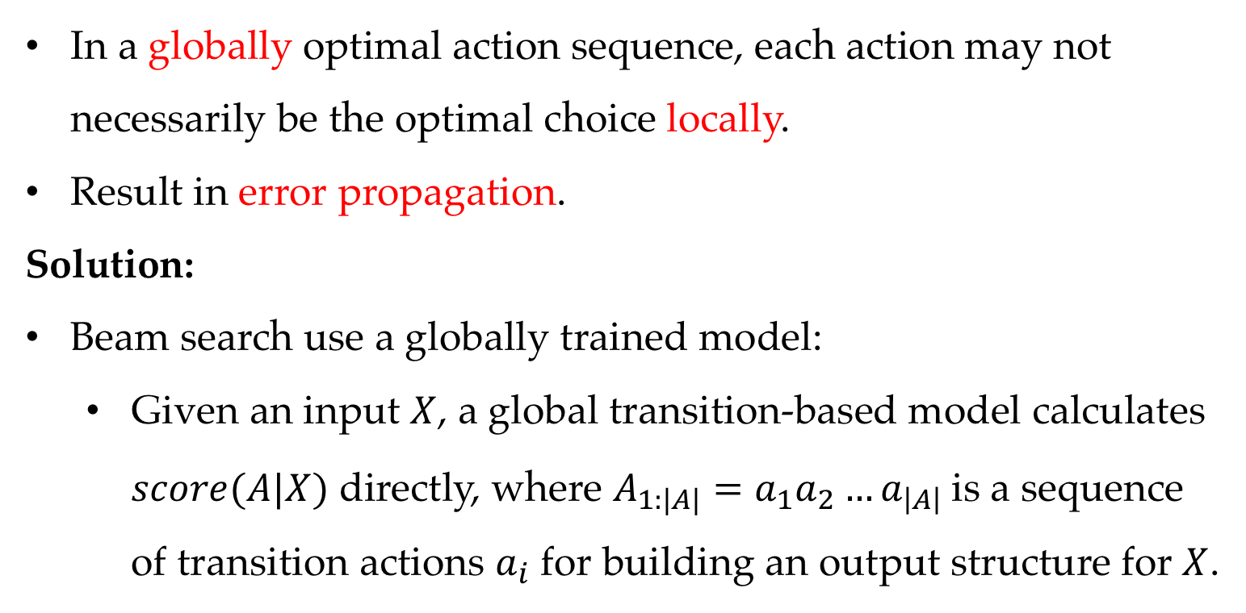
Problem of Greedy Local Modeling
In a globally optimal action sequence, each action may not necessarily be the optimal choice locally.
Result in error propagation.
Solution:
Beam search use a globally trained model:
Given an input $X$, a global transition-based model calculates $score(A|X)$ directly, where $A_{1:|A|}=a_{1}a_{2}…a_{\left|A\right|}$is a sequence of transition actions $a_{i}$ for building an output structure for $X$.

Slide 55
Beam search decoding example
He does it here

Slide 56
Beam search decoding example
He does it here
S
He
does it here

Slide 57
Beam search decoding example
He does it here
S
He
AL
does it here
does it here
AR
He
S
He does
it here
He does
it here

Slide 58
Beam search decoding example
He does it here
S
He
AL
S
does it here
does it here
it here
does
AR
He
He
S
He does
S
it here
He does it
here
AR
He does
it here
He does it
here
S
AR

Slide 59
Beam search decoding example
He does it here
S
He
AL
S
does it here
does it here
it here
does
AR
He
He
S
He does
S
it here
He does it
here
AR
He does
it here
He does it
here
S
AR
does it
here
He
He does it here
here
He does
it

Slide 60
Beam search decoding example
He does it here
S
He
AL
S
does it here
does it here
it here
does
AR
He
He
S
He does
S
it here
He does it
here
AR
He does
it here
He does it
here
S
AR
does it here
does it
here
He
He
He
does
here
He
it
He does it here
He
does it here
here
He does
He
it

Slide 61
Beam search decoding example
He does it here
S
He
AL
S
does it here
does it here
it here
does
AR
He
He
S
He does
S
it here
He does it
here
AR
He does
it here
He does it
here
S
AR
does here
does it here
does it
here
He
it
He
He
He
does here
does
here
He
it
He does it here
He
it
He
does it here
does it here
here
He does
He
He
it

Slide 62
Beam search decoding example
He does it here
S
He
AL
S
does it here
does it here
it here
does
AR
He
He
S
He does
S
it here
He does it
here
AR
He does
it here
He does it
here
S
AR
does
does here
does it here
does it
here
He
it
He
it
He
here
He
He
does here
does
here
He
it
He does it here
He
it
He
does it
does it here
does it here
here
He does
He here
He
He
it

Slide 63
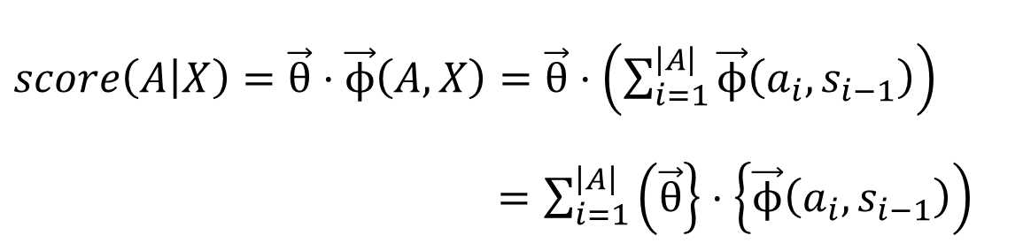
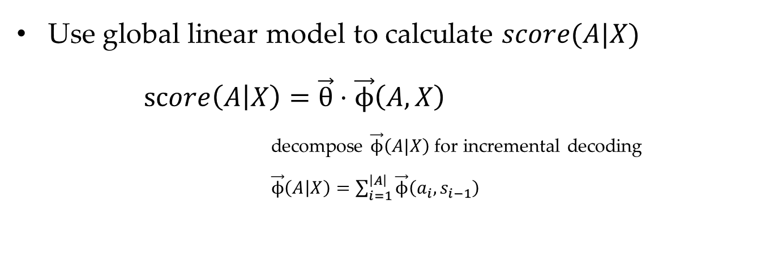
Solution
Use global linear model to calculate $score(A|X)$
$score\left(A | X\right)=\vec{θ}⋅\vec{ϕ}\left(A,X\right)$
decompose $\vec{ϕ}\left(A|X\right)$for incremental decoding
$\vec{ϕ}\left(A | X\right)=\sum_{i=1}^{\left|A\right|}{\vec{ϕ}\left(a_{i},s_{i−1}\right)}$
$score\left(A | X\right)=\vec{θ}⋅\vec{ϕ}\left(A,X\right)=\vec{θ}⋅\left(\sum_{i=1}^{\left|A\right|}{\vec{ϕ}\left(a_{i},s_{i−1}\right)}\right)$
$=\sum_{i=1}^{\left|A\right|}{\left(\vec{θ}\right\}⋅\left\{\vec{ϕ}\left(a_{i},s_{i−1}\right)\right)}$

Slide 64
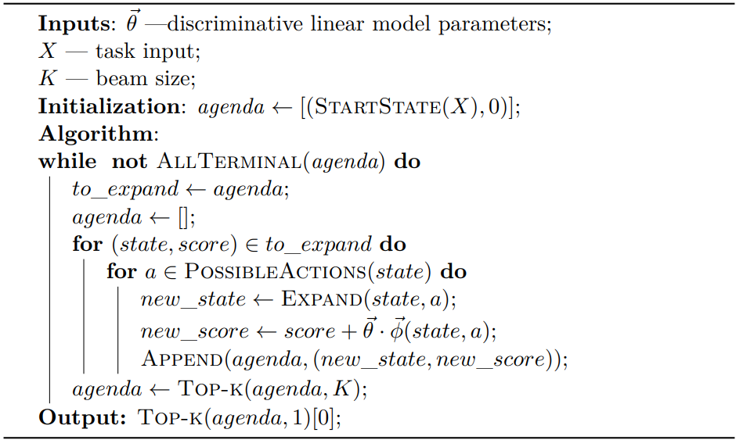
Beam search decoding algorithm

Slide 65
Beam search decoding example
Dependency parsing
He does it here

Slide 66
Beam search decoding example
Dependency parsing
He does it here
S
He
does it here
S-SHIFT

Slide 67
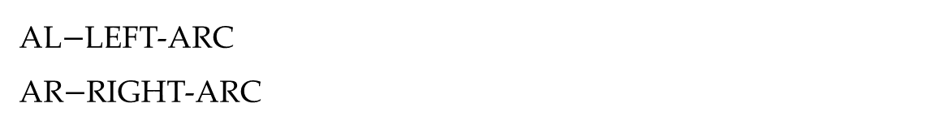
Beam search decoding example
Dependency parsing
He
does it here
AL
does it here
AR
He
S
He does
it here
He does
it here
AL$−$LEFT-ARC
AR$−$RIGHT-ARC

Slide 68
Beam search decoding example
Dependency parsing
He
does it here
does
it here
S
He
He does
it here
S
He does it
here
AR
He does
it here
He does it
here
S
AR

Slide 69
Beam search decoding example
Dependency parsing
does
it here
does it
here
He
He
He does it
here
He does it here
here
He does
He does it
here
it

Slide 70
Beam search decoding example
Dependency parsing
does it here
does it
here
He
does
He does it here
He
it
here
does it here
He does
it
He

Slide 71
Beam search decoding example
Dependency parsing
does it here
does here
does
He
it
does here
He
it
He
it
does it here
does it here
He
He

Slide 72
Beam search decoding example
Dependency parsing
does here
does
He
it
does here
He
it
here
He
it
does it here
does it
He
He here

Slide 73
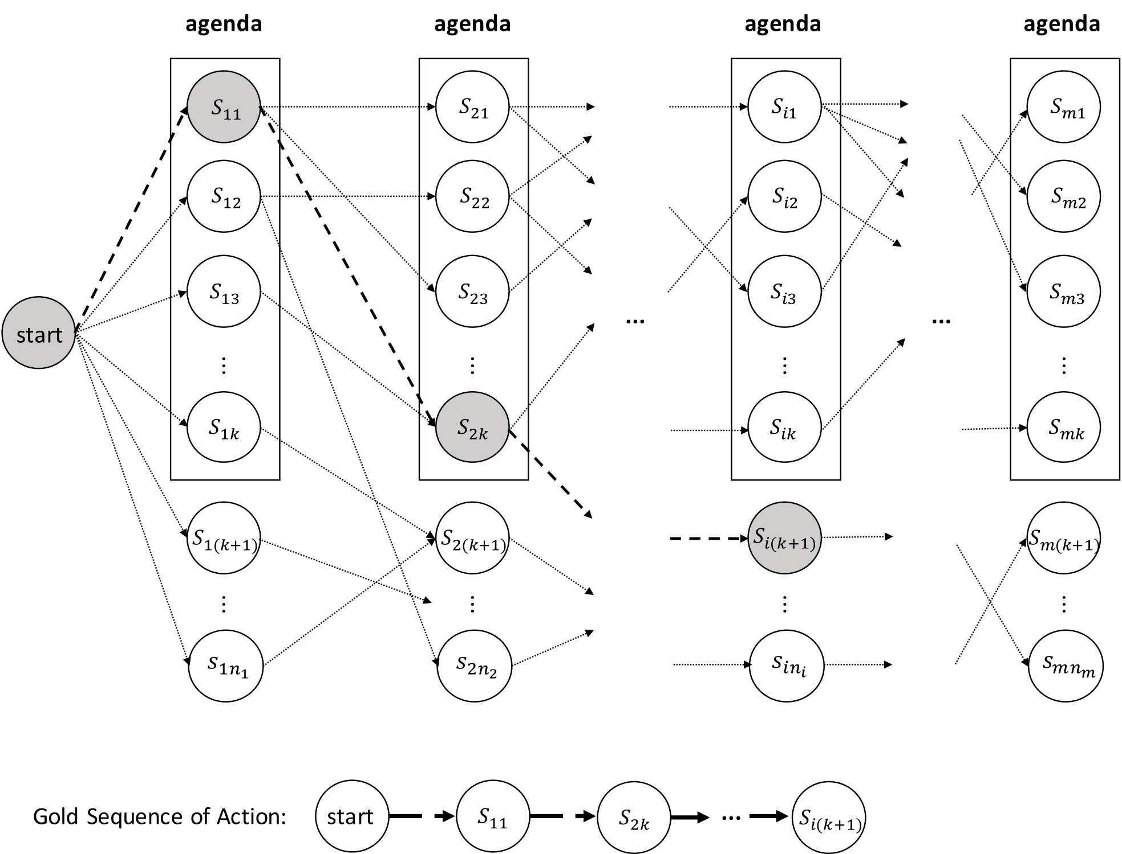
Beam search decoding example

Slide 74
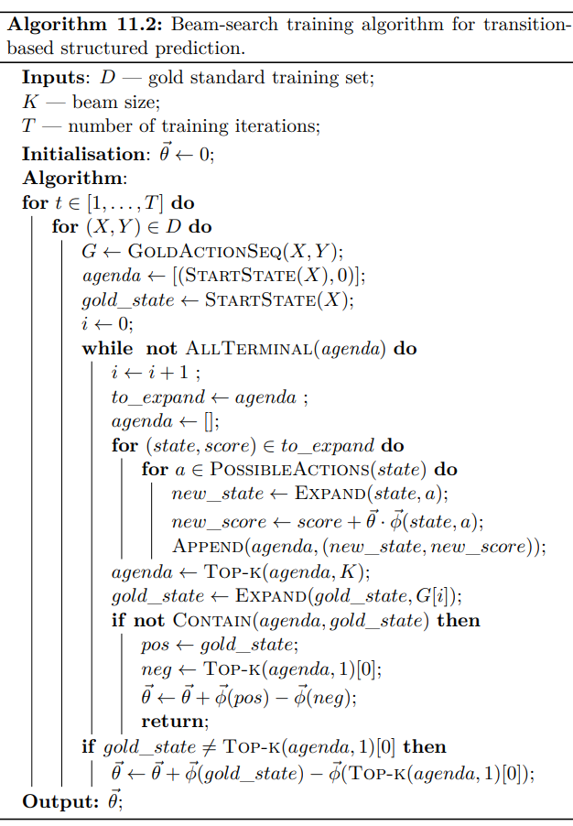
Beam search training algorithm

Slide 75
Contents
11.1 Transition-based Structured Prediction
11.1.1 Greedy Local Modelling
11.1.2 Structured Modelling
11.2 Transition-based Constituent Parsing
11.2.1 Shift-reduce Constituent Parsing
11.2.2 Feature Templates
11.3 Shift-reduce Dependency Parsing
11.3.1 Arc-standard Dependency Parsing
11.3.2 Arc-eager Projective Parsing
11.3.3 The Swap Action and Non-projective Trees
11.4 Joint Models
11.4.1 Joint POS-tagging and Dependency Parsing
11.4.2 Joint Word Segmentation, POS-tagging and Dependency Parsing

Slide 76
Transition-based constituent parsing
Three steps in transition-based modeling
Find the state transition process
Define global feature vector
Apply the standard learning and search framework

Slide 77
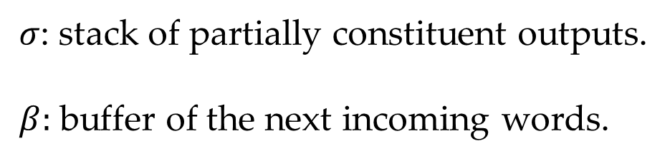
Transition-based constituent parsing
State
$σ$: stack of partially constituent outputs.
$β:$ buffer of the next incoming words.
actions
SHIFT, REDUCE-L/R-X, UNARY-X, IDLE

Slide 78
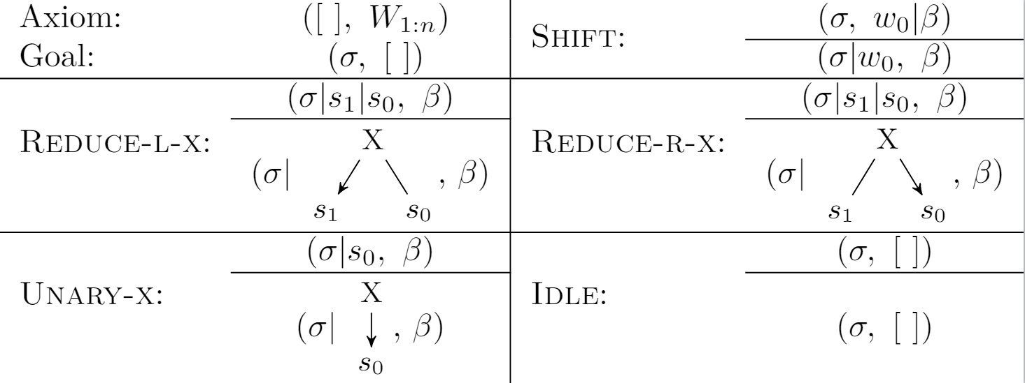
Transition-based constituent parsing
Shift-reduce constituent parsing

Slide 79
Transition-based constituent parsing
Shift-reduce constituent parsing
Example
Shift
stack
buffer
DT
ADJ
NN
VV
ADJ
NNS
.
The
little
boy
likes
red
tomatoes
.

Slide 80
Transition-based constituent parsing
Shift-reduce constituent parsing
Example
Shift
stack
buffer
DT
ADJ
NN
VV
ADJ
NNS
.
The
little
boy
likes
red
tomatoes
.

Slide 81
Transition-based constituent parsing
Shift-reduce constituent parsing
Example
Shift
stack
buffer
DT
ADJ
NN
VV
ADJ
NNS
.
The
little
boy
likes
red
tomatoes
.

Slide 82
Transition-based constituent parsing
Shift-reduce constituent parsing
Example
Reduce-R-NP
stack
buffer
DT
ADJ
NN
VV
ADJ
NNS
.
The
little
boy
likes
red
tomatoes
.

Slide 83
Transition-based constituent parsing
Shift-reduce constituent parsing
Example
Reduce-R-NP
stack
buffer
DT
VV
ADJ
NNS
.
NP*
The
likes
red
tomatoes
.
ADJ
NN
little
boy

Slide 84
Transition-based constituent parsing
Shift-reduce constituent parsing
Example
Shift
stack
buffer
VV
ADJ
NNS
.
NP*
likes
red
tomatoes
.
DT
NP*
The
ADJ
NN
little
boy

Slide 85
Transition-based constituent parsing
Shift-reduce constituent parsing
Example
Shift
stack
buffer
VV
ADJ
NNS
.
NP*
likes
red
tomatoes
.
DT
NP*
The
ADJ
NN
little
boy

Slide 86
Transition-based constituent parsing
Shift-reduce constituent parsing
Example
Shift
stack
buffer
VV
ADJ
NNS
.
NP*
likes
red
tomatoes
.
DT
NP*
The
ADJ
NN
little
boy

Slide 87
Transition-based constituent parsing
Shift-reduce constituent parsing
Example
Reduce-R-NP
stack
buffer
VV
ADJ
NNS
.
NP*
likes
red
tomatoes
.
DT
NP*
The
ADJ
NN
little
boy

Slide 88
Transition-based constituent parsing
Shift-reduce constituent parsing
Example
Reduce-L-VP
stack
buffer
VV
.
NP*
NP*
likes
.
DT
NP*
ADJ
NNS
The
red
tomatoes
ADJ
NN
little
boy

Slide 89
Transition-based constituent parsing
Shift-reduce constituent parsing
Example
Shift
stack
buffer
.
NP*
VP*
.
DT
NP*
VV
NP*
The
likes
ADJ
NNS
ADJ
NN
little
boy
red
tomatoes

Slide 90
Transition-based constituent parsing
Shift-reduce constituent parsing
Example
Reduce-L-S
stack
buffer
.
NP*
VP*
.
DT
NP*
VV
NP*
The
likes
ADJ
NNS
ADJ
NN
little
boy
red
tomatoes

Slide 91
Transition-based constituent parsing
Shift-reduce constituent parsing
Example
Reduce-R-S
stack
buffer
NP*
S*
DT
NP*
VP*
.
The
VV
NP*
.
ADJ
NN
little
boy
likes
ADJ
NNS
red
tomatoes

Slide 92
Transition-based constituent parsing
Shift-reduce constituent parsing
Example
Terminate
stack
buffer
S*
NP*
S*
DT
NP*
VP*
.
The
VV
NP*
.
ADJ
NN
little
boy
likes
ADJ
NNS
red
tomatoes

Slide 93
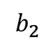
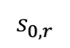
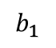
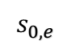
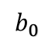
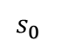
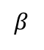
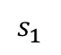
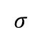
Transition-based constituent parsing
Feature Templates for Shift-reduce Constituent Parser
Example state
$$σ$$
$$β$$
$$s_{1}$$
$$s_{0}$$
$$b_{0}$$
$$b_{1}$$
$$b_{2}$$
DT
NP
likes
red
tomatoes
The
ADJ
NN
little
boy
$$s_{0,e}$$
$$s_{0,r}$$

Slide 94
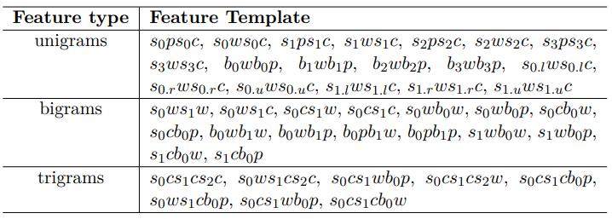
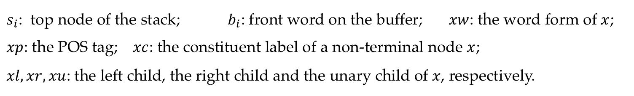
Transition-based constituent parsing
Feature Templates for Shift-reduce Constituent Parser
$s_{i}$: top node of the stack; $b_{i}$: front word on the buffer; $xw$: the word form of $x$;
$xp$: the POS tag; $xc$: the constituent label of a non-terminal node $x$;
$xl,xr,xu$: the left child, the right child and the unary child of $x$, respectively.

Slide 95
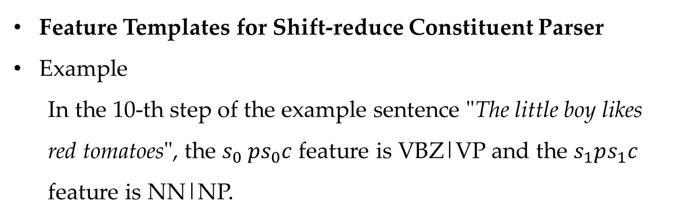
Transition-based constituent parsing
Feature Templates for Shift-reduce Constituent Parser
Example
In the 10-th step of the example sentence "The little boy likes red tomatoes", the $s_{0} ps_{0}c$ feature is VBZ|VP and the $s_{1}ps_{1}c$ feature is NN|NP.
.
NP-r
VP-l
.
DT
NP-r
VV
NP-r
The
likes
ADJ
NNS
ADJ
NN
little
boy
red
tomatoes

Slide 96
Contents
11.1 Transition-based Structured Prediction
11.1.1 Greedy Local Modelling
11.1.2 Structured Modelling
11.2 Transition-based Constituent Parsing
11.2.1 Shift-reduce Constituent Parsing
11.2.2 Feature Templates
11.3 Shift-reduce Dependency Parsing
11.3.1 Arc-standard Dependency Parsing
11.3.2 Arc-eager Projective Parsing
11.3.3 The Swap Action and Non-projective Trees
11.4 Joint Models
11.4.1 Joint POS-tagging and Dependency Parsing
11.4.2 Joint Word Segmentation, POS-tagging and Dependency Parsing

Slide 97
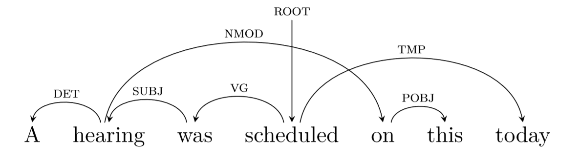
Shift-reduce dependency parsing
Projective dependency tree
Non-projective dependency tree

Slide 98
Contents
11.1 Transition-based Structured Prediction
11.1.1 Greedy Local Modelling
11.1.2 Structured Modelling
11.2 Transition-based Constituent Parsing
11.2.1 Shift-reduce Constituent Parsing
11.2.2 Feature Templates
11.3 Shift-reduce Dependency Parsing
11.3.1 Arc-standard Dependency Parsing
11.3.2 Arc-eager Projective Parsing
11.3.3 The Swap Action and Non-projective Trees
11.4 Joint Models
11.4.1 Joint POS-tagging and Dependency Parsing
11.4.2 Joint Word Segmentation, POS-tagging and Dependency Parsing

Slide 99
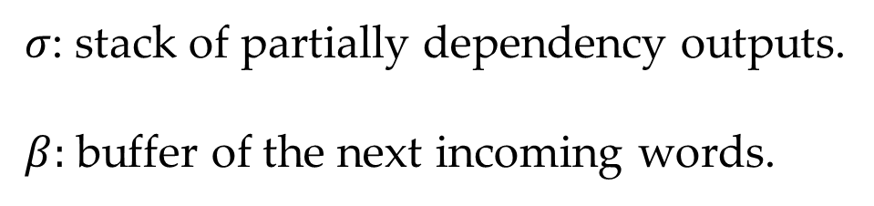
Shift-reduce dependency parsing
Arc-standard Parsing
State
$σ$: stack of partially dependency outputs.
$β:$ buffer of the next incoming words.
actions
SHIFT, LEFT-ARC-X, RIGHT-ARC-X

Slide 100
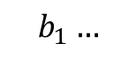
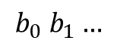
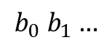
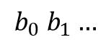
Shift-reduce dependency parsing
Actions
... S₁ S₀
$$b_{0} b_{1}…$$
SHIFT
... S₁ S₀ b₀
$$b_{1}…$$
LEFT-ARC
... S₀
$$b_{0} b_{1}…$$
S₁
RIGHT-ARC
... S₁
$$b_{0} b_{1}…$$
S₀

Slide 101
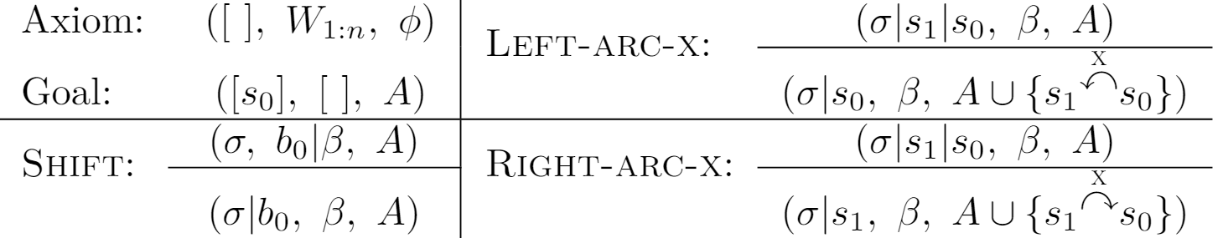
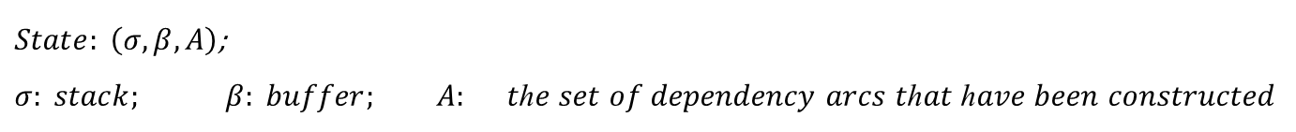
Shift-reduce dependency parsing
Arc-standard Dependency Parsing
$State: \left(σ,β,A\right)$;
$σ: stack;$ $β: buffer;$ $A:$ 𝑡ℎ𝑒 𝑠𝑒𝑡 𝑜𝑓 𝑑𝑒𝑝𝑒𝑛𝑑𝑒𝑛𝑐𝑦 𝑎𝑟𝑐𝑠 𝑡ℎ𝑎𝑡 ℎ𝑎𝑣𝑒 𝑏𝑒𝑒𝑛 𝑐𝑜𝑛𝑠𝑡𝑟𝑢𝑐𝑡𝑒𝑑
Notes:
Add a figure for Action List

Slide 102

Arc-standard dependency parsing
Example
Sentence “He gave her a tomato”
Next action: SHIFT

Slide 103
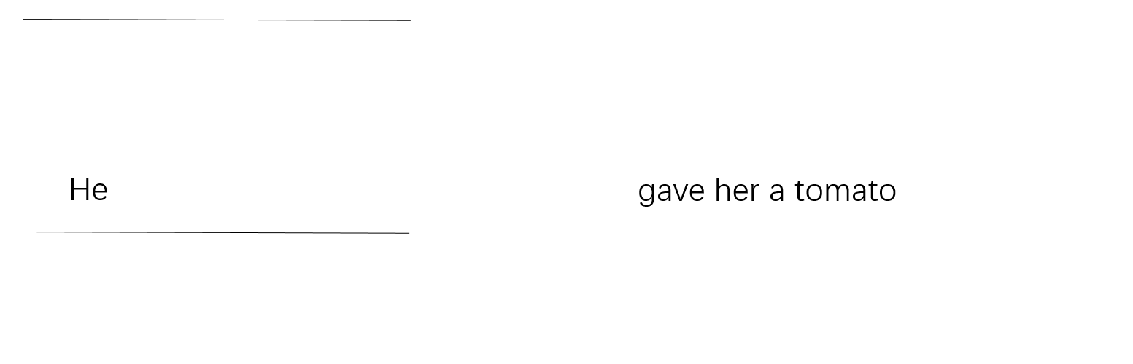
Arc-standard dependency parsing
Example
Sentence “He gave her a tomato”
Next action: SHIFT

Slide 104

Arc-standard dependency parsing
Example
Sentence “He gave her a tomato”
Next action: LEFT-ARC-SUBJ

Slide 105

Arc-standard dependency parsing
Example
Sentence “He gave her a tomato”
Next action: SHIFT

Slide 106

Arc-standard dependency parsing
Example
Sentence “He gave her a tomato”
Next action: RIGHT-ARC-IOBJ

Slide 107

Arc-standard dependency parsing
Example
Sentence “He gave her a tomato”
Next action: SHIFT

Slide 108

Arc-standard dependency parsing
Example
Sentence “He gave her a tomato”
Next action: SHIFT

Slide 109

Arc-standard dependency parsing
Example
Sentence “He gave her a tomato”
Next action: LEFT-ARC-DET

Slide 110

Arc-standard dependency parsing
Example
Sentence “He gave her a tomato”
Next action: RIGHT-ARC-DOBJ

Slide 111

Arc-standard dependency parsing
Example
Sentence “He gave her a tomato”
Next action: END

Slide 112

Shift-reduce dependency parsing
Arc-standard Dependency Parsing
Example state

Slide 113

Arc-standard dependency parsing
Feature Templates for arc-standard dependency parsing

Slide 114
Contents
11.1 Transition-based Structured Prediction
11.1.1 Greedy Local Modelling
11.1.2 Structured Modelling
11.2 Transition-based Constituent Parsing
11.2.1 Shift-reduce Constituent Parsing
11.2.2 Feature Templates
11.3 Shift-reduce Dependency Parsing
11.3.1 Arc-standard Dependency Parsing
11.3.2 Arc-eager Projective Parsing
11.3.3 The Swap Action and Non-projective Trees
11.4 Joint Models
11.4.1 Joint POS-tagging and Dependency Parsing
11.4.2 Joint Word Segmentation, POS-tagging and Dependency Parsing

Slide 115

Shift-reduce dependency parsing
Arc-eager Parsing
State
$σ$: stack of partially constituent outputs.
$β:$ buffer of the next incoming words.
actions
SHIFT, LEFT-ARC-X, RIGHT-ARC-X, REDUCE

Slide 116

Shift-reduce dependency parsing
Arc-eager dependency parsing
Example

Slide 117





Shift-reduce dependency parsing
Actions
... S₁ S₀
$$b_{0} b_{1}…$$
SHIFT
... S₁ S₀ b₀
$$b_{1}…$$
LEFT-ARC
... S₁
$$b_{0} b_{1}…$$
S₀
RIGHT-ARC
... S₁
b₀
$$b_{1}…$$
REDUCE
... S₁
$$b_{0} b_{1}…$$

Slide 118


Shift-reduce dependency parsing
Arc-eager dependency parsing
Main differences comparing with arc-standard:
$Left−Arc−X/Right−Arc−X$: construct a dependency arc from the front word on the buffer to the top word on the stack, but not as that (from the top two words on the stack) in arc-standard.
$Reduce$: pop the top word off the stack.

Slide 119
Example (Dependency Parsing)
NEXT ACTION: $Shift$
$$σ$$
$$β$$
He does it here
$σ$: stack $β:$ buffer

Slide 120
Example (Dependency Parsing)
NEXT ACTION: $Left−Arc−SUBJ$
$$σ$$
$$β$$
He
does it here
$σ$: stack $β:$ buffer

Slide 121
Example (Dependency Parsing)
NEXT ACTION: $Shift$
$$σ$$
$$β$$
does it here
He
$σ$: stack $β:$ buffer

Slide 122
Example (Dependency Parsing)
NEXT ACTION: $Right−Arc−OBJ$
$$σ$$
$$β$$
does
it here
He
$σ$: stack $β:$ buffer

Slide 123
Example (Dependency Parsing)
NEXT ACTION: $Reduce$
$$σ$$
$$β$$
does it
here
He
$σ$: stack $β:$ buffer

Slide 124
Example (Dependency Parsing)
NEXT ACTION: $Right−Arc−MOD$
$$σ$$
$$β$$
does
here
He it
$σ$: stack $β:$ buffer

Slide 125
Example (Dependency Parsing)
NEXT ACTION: $Reduce$
$$σ$$
$$β$$
does here
He it
$σ$: stack $β:$ buffer

Slide 126
Example (Dependency Parsing)
NEXT ACTION: $Finish$
$$σ$$
$$β$$
does
He it here
$σ$: stack $β:$ buffer

Slide 127
Contents
11.1 Transition-based Structured Prediction
11.1.1 Greedy Local Modelling
11.1.2 Structured Modelling
11.2 Transition-based Constituent Parsing
11.2.1 Shift-reduce Constituent Parsing
11.2.2 Feature Templates
11.3 Shift-reduce Dependency Parsing
11.3.1 Arc-standard Dependency Parsing
11.3.2 Arc-eager Projective Parsing
11.3.3 The Swap Action and Non-projective Trees
11.4 Joint Models
11.4.1 Joint POS-tagging and Dependency Parsing
11.4.2 Joint Word Segmentation, POS-tagging and Dependency Parsing

Slide 128

Shift-reduce dependency parsing
The Swap Action and Non-projective Trees
To allow constructing non-projective trees, the arc-standard system can be extended by adding a new action:
$Swap$: remove the second top word from the stack, pushing it onto the buffer front.

Slide 129


Shift-reduce dependency parsing
Arc-standard Dependency Parsing with Swap Action
$State$: $(σ,β,A)$; $σ$: stack; $β$: buffer; $A$: the set of dependency arcs that have been constructed; $IDX(w)$: return the index of $w$ in the sentence $W_{1:n}$.

Slide 130

Shift-reduce dependency parsing
Arc-standard Dependency Parsing with Swap Action
Example
Next action: SHIFT
Notes:
Add example for “he gave me a tomato”

Slide 131

Shift-reduce dependency parsing
Arc-standard Dependency Parsing with Swap Action
Example
Next action: SHIFT

Slide 132

Shift-reduce dependency parsing
Arc-standard Dependency Parsing with Swap Action
Example
Next action: LEFT-ARC-DET

Slide 133

Shift-reduce dependency parsing
Arc-standard Dependency Parsing with Swap Action
Example
Next action: SHIFT

Slide 134

Shift-reduce dependency parsing
Arc-standard Dependency Parsing with Swap Action
Example
Next action: SHIFT

Slide 135

Shift-reduce dependency parsing
Arc-standard Dependency Parsing with Swap Action
Example
Next action: SHIFT

Slide 136

Shift-reduce dependency parsing
Arc-standard Dependency Parsing with Swap Action
Example
Next action: SWAP

Slide 137

Shift-reduce dependency parsing
Arc-standard Dependency Parsing with Swap Action
Example
Next action: SWAP

Slide 138

Shift-reduce dependency parsing
Arc-standard Dependency Parsing with Swap Action
Example
Next action: SHIFT

Slide 139

Shift-reduce dependency parsing
Arc-standard Dependency Parsing with Swap Action
Example
Next action: SHIFT

Slide 140

Shift-reduce dependency parsing
Arc-standard Dependency Parsing with Swap Action
Example
Next action: SHIFT

Slide 141

Shift-reduce dependency parsing
Arc-standard Dependency Parsing with Swap Action
Example
Next action: SWAP

Slide 142

Shift-reduce dependency parsing
Arc-standard Dependency Parsing with Swap Action
Example
Next action: SWAP

Slide 143

Shift-reduce dependency parsing
Arc-standard Dependency Parsing with Swap Action
Example
Next action: RIGHT-ARC-POBJ

Slide 144

Shift-reduce dependency parsing
Arc-standard Dependency Parsing with Swap Action
Example
Next action: RIGHT-ARC-NMOD

Slide 145

Shift-reduce dependency parsing
Arc-standard Dependency Parsing with Swap Action
Example
Next action: SHIFT

Slide 146

Shift-reduce dependency parsing
Arc-standard Dependency Parsing with Swap Action
Example
Next action: LEFT-ARC-SUBJ

Slide 147

Shift-reduce dependency parsing
Arc-standard Dependency Parsing with Swap Action
Example
Next action: SHIFT

Slide 148

Shift-reduce dependency parsing
Arc-standard Dependency Parsing with Swap Action
Example
Next action: SHIFT

Slide 149

Shift-reduce dependency parsing
Arc-standard Dependency Parsing with Swap Action
Example
Next action: RIGHT-ARC-TMP

Slide 150

Shift-reduce dependency parsing
Arc-standard Dependency Parsing with Swap Action
Example
Next action: LEFT-ARC-VG

Slide 151

Shift-reduce dependency parsing
Arc-standard Dependency Parsing with Swap Action
Example
Next action: END

Slide 152
Contents
11.1 Transition-based Structured Prediction
11.1.1 Greedy Local Modelling
11.1.2 Structured Modelling
11.2 Transition-based Constituent Parsing
11.2.1 Shift-reduce Constituent Parsing
11.2.2 Feature Templates
11.3 Shift-reduce Dependency Parsing
11.3.1 Arc-standard Dependency Parsing
11.3.2 Arc-eager Projective Parsing
11.3.3 The Swap Action and Non-projective Trees
11.4 Joint Models
11.4.1 Joint POS-tagging and Dependency Parsing
11.4.2 Joint Word Segmentation, POS-tagging and Dependency Parsing

Slide 153
Joint Models
Motivations
Cross-task information sharing
Reduction of error propagation
Challenge
Much enlarged search space with irregular combined structures.
Example
Joint POS-tagging and syntactic parsing
Joint word segmentation, POS-tagging and parsing
Joint named entity extraction and relation extraction.

Slide 154

Joint Models
Joint POS-tagging and Dependency Parsing
Input: $W_{1:n}=w_{1},…,w_{n}$
Output: $(T_{1:n},A)$, where $t_{i}$ is POS for $w_{i}$.
The arc-standard algorithm can be extended by replacing $SHIFT$action with $SHIFT−X$ action
$SHIFT−X$, which removes the front word from the buﬀer, assigning the POS label $X$ to the word, and pushing it onto the stack.

Slide 155
Joint Models
Joint POS-tagging and Dependency Parsing
Example
Next action: SHIFT-PRP
Stack [S]
Buffer [B]
He₁ won₂ the₃ game₄

Slide 156
Joint Models
Joint POS-tagging and Dependency Parsing
Example
Next action: SHIFT-VBD
Stack [S]
Buffer [B]
He_{1/PRP}
won₂ the₃ game₄

Slide 157
Joint Models
Joint POS-tagging and Dependency Parsing
Example
Next action: LEFT-ARC-NSUBJ
Stack [S]
Buffer [B]
He_{1/PRP} won₂
the₃ game₄

Slide 158
Joint Models
Joint POS-tagging and Dependency Parsing
Example
Next action: SHIFT-DT
Stack [S]
Buffer [B]
He_{1/PRP} won_{2/VBD}
the₃ game₄
nusbj

Slide 159
Joint Models
Joint POS-tagging and Dependency Parsing
Example
Next action: SHIFT-NN
Stack [S]
Buffer [B]
He_{1/PRP} won_{2/VBD} the_{3/DT}
game₄
nusbj

Slide 160
Joint Models
Joint POS-tagging and Dependency Parsing
Example
Next action: LEFT-ARC-DET
Stack [S]
Buffer [B]
He_{1/PRP} won_{2/VBD} the_{3/DT} game_{4/NN}
nusbj

Slide 161
Joint Models
Joint POS-tagging and Dependency Parsing
Example
Next action: RIGHT-ARC-DOBJ
Stack [S]
Buffer [B]
He_{1/PRP} won_{2/VBD} the_{3/DT} game_{4/NN}
nusbj
det

Slide 162
Joint Models
Joint POS-tagging and Dependency Parsing
Example
Next action: END
Stack [S]
Buffer [B]
He_{1/PRP} won_{2/VBD} the_{3/DT} game_{4/NN}
nusbj
det
dobj

Slide 163
Contents
11.1 Transition-based Structured Prediction
11.1.1 Greedy Local Modelling
11.1.2 Structured Modelling
11.2 Transition-based Constituent Parsing
11.2.1 Shift-reduce Constituent Parsing
11.2.2 Feature Templates
11.3 Shift-reduce Dependency Parsing
11.3.1 Arc-standard Dependency Parsing
11.3.2 Arc-eager Projective Parsing
11.3.3 The Swap Action and Non-projective Trees
11.4 Joint Models
11.4.1 Joint POS-tagging and Dependency Parsing
11.4.2 Joint Word Segmentation, POS-tagging and Dependency Parsing

Slide 164


Joint Models
Joint Word Segmentation, POS-tagging and Dependency Parsing
Input:${ C}_{1:n}=c_{1}…c_{n}$
Output: $(W_{1:m },T_{1:m}, A)$ where $w_{1}…w_{m}$are words, $t_{1}…t_{n}$ are POS, and $A$ is the set of dependency arcs.
Also consider the dependencies within each word.

Slide 165

Joint Models
Joint Word Segmentation, POS-tagging and Dependency Parsing
Input:${ C}_{1:n}=c_{1}…c_{n}$
Output: $(W_{1:m },T_{1:m}, A)$ where $w_{1}…w_{m}$are words, $t_{1}…t_{n}$ are POS, and $A$ is the set of dependency arcs.
State:
$σ$ -- partially built outputs
$δ$ -- words
$β$ -- incoming characters
$A_{c}$-- character dependencies
$A_{w}$-- word dependencies

Slide 166


Joint Models
Joint Word Segmentation, POS-tagging and Dependency Parsing
$State:(σ,δ,β,A_c,A_w)$ $σ$: stack; $β$:buffer; $δ$: partial-word buffer;
$A_{c}$: the set of character dependencies; $A_{w}$: the set of word dependencies

Slide 167


Joint Models
Joint Word Segmentation, POS-tagging and Dependency Parsing
Example

Slide 168


Joint Models
Joint Word Segmentation, POS-tagging and Dependency Parsing
Example

Slide 169


Joint Models
Joint Word Segmentation, POS-tagging and Dependency Parsing
Example

Slide 170


Joint Models
Joint Word Segmentation, POS-tagging and Dependency Parsing
Example

Slide 171


Joint Models
Joint Word Segmentation, POS-tagging and Dependency Parsing
Example

Slide 172


Joint Models
Joint Word Segmentation, POS-tagging and Dependency Parsing
Example
-C

Slide 173


Joint Models
Joint Word Segmentation, POS-tagging and Dependency Parsing
Example

Slide 174


Joint Models
Joint Word Segmentation, POS-tagging and Dependency Parsing
Example

Slide 175


Joint Models
Joint Word Segmentation, POS-tagging and Dependency Parsing
Example

Slide 176


Joint Models
Joint Word Segmentation, POS-tagging and Dependency Parsing
Example

Slide 177


Joint Models
Joint Word Segmentation, POS-tagging and Dependency Parsing
Example

Slide 178


Joint Models
Joint Word Segmentation, POS-tagging and Dependency Parsing
Example

Slide 179


Joint Models
Joint Word Segmentation, POS-tagging and Dependency Parsing
Example

Slide 180


Joint Models
Joint Word Segmentation, POS-tagging and Dependency Parsing
Example

Slide 181


Joint Models
Joint Word Segmentation, POS-tagging and Dependency Parsing
Example

Slide 182


Joint Models
Joint Word Segmentation, POS-tagging and Dependency Parsing
Example

Slide 183


Joint Models
Joint Word Segmentation, POS-tagging and Dependency Parsing
Example

Slide 184


Joint Models
Joint Word Segmentation, POS-tagging and Dependency Parsing
Example

Slide 185
Summary
What is transition-based method?
Apply transition-based methods on different tasks.
Joint modeling with transition-based methods.

